Slide 1

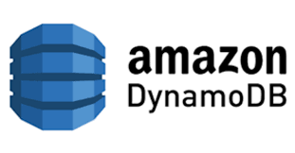


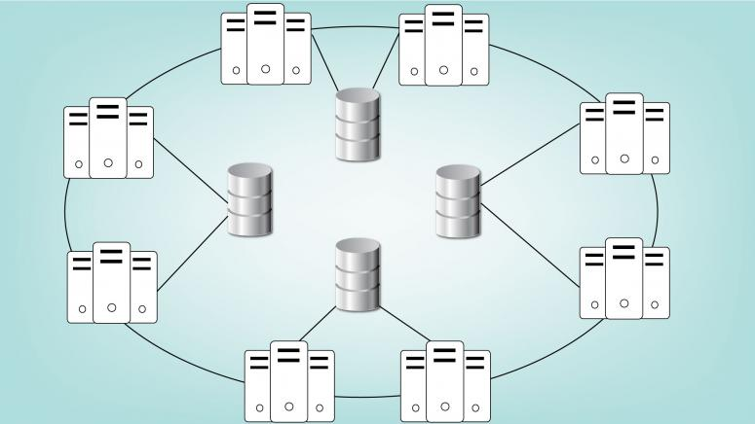
Serverless Application using Lambda and DynamoDB with Auto Scaling
Presented By : Smit Parmar
Geetika Rathi
Harman Preet Kaur
Shubhang Khattar
COMP 6231

Slide 2
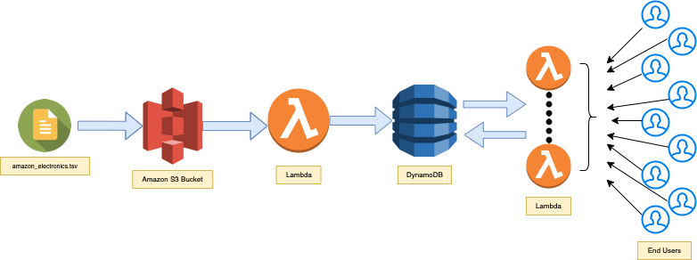
Overview
To show functionality of distributed system such as autoscaling, replication, fault tolerance, partition of data and consistency in the serverless application.
For that, we have used DynamoDB as NO-SQL database, lambda for middleware processes and react for front-end. As we have used lambda, we don't need to use any dedicated server thus it will be serverless.
Our application will get productID and will give top 100 reviews of particular product.

Slide 3
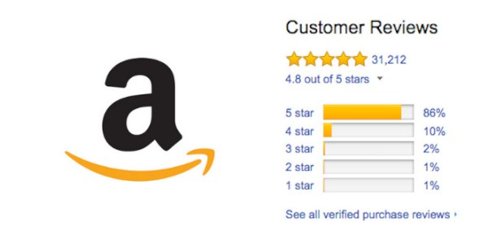
Amazon US Customer Reviews Data Set
2.2 GB (Approximately 3 million records)
Data set contains the following information -
amazon_reviews_us_Electronics_v1_00.tsv
A collection of reviews written in the Amazon.com marketplace and associated metadata from 1995 until 2015. This is intended to facilitate study into the properties (and the evolution) of customer reviews potentially including how people evaluate and express their experiences with respect to products at scale.

Slide 4
About DynamoDB
DynamoDB is NO-SQL database with different type of keys where primary key is hashed and store indexes. Additionally, DynamoDB Streams auto-scales the number of shards based on traffic. The number of shards in a DynamoDB stream is tied to the number of partitions in the table.
Features:
Auto-Scaling and Performance
Fault-tolerant
Access to Control Rules
Automatic Data Management
Storage of inconsistent schema items

Slide 5
AWS Lambda (Serverless Computing)
AWS Lambda is a serverless computing service provided by Amazon Web Services (AWS).
The Lambda functions can perform any kind of computing task, from serving web pages and processing streams of data to calling APIs and integrating with other AWS services.
Load Balancing
Auto Scaling
Handle Failures
Security Isolation
OS Management

Slide 6
WorkFlow
tsv data file
(Size : 2.2 GB)
Uploading file to S3 Storage first.
Since Data cannot be add to DynamoDB, we used Lambda Function.
Data stored in DynamoDB which is partitioned with multiple hash keys.
Lambda function fulfilling the Users request and is capable of auto scaling as with the users.
End user with serverless application

Slide 7
Setting up data in DynamoDB
DynamoDB does not support import of any kind of file. Thus, we added another layer for that.
We have uploaded dataset to S3 and then we have used lambda function to preprocess it. Then by using same lambda function, we did migration of all data.
Lambda has basically timeout of 15 minutes and it can autoscale and will be available as there will be replicas across different regions.
AWS make new instances to run query at every 700-1000 Request Units which is another form of scaling too.
We have used approx 2000 WRU (Read Write Units) while migrating.

Slide 8
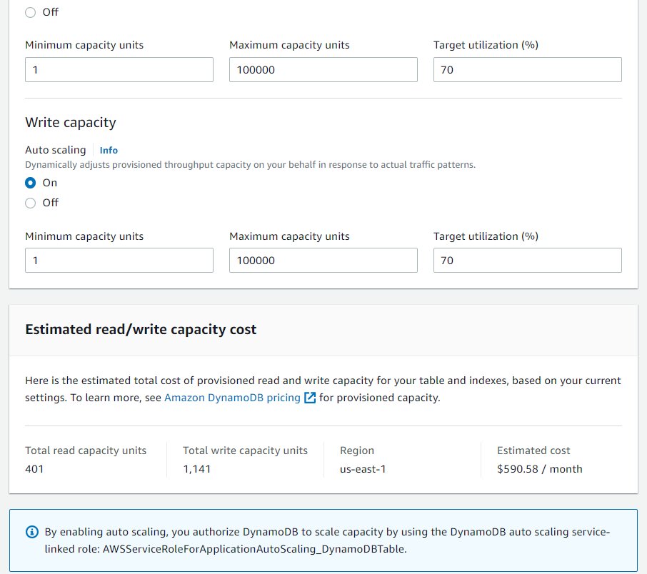
Configuration
Of DynamoDB

Slide 9
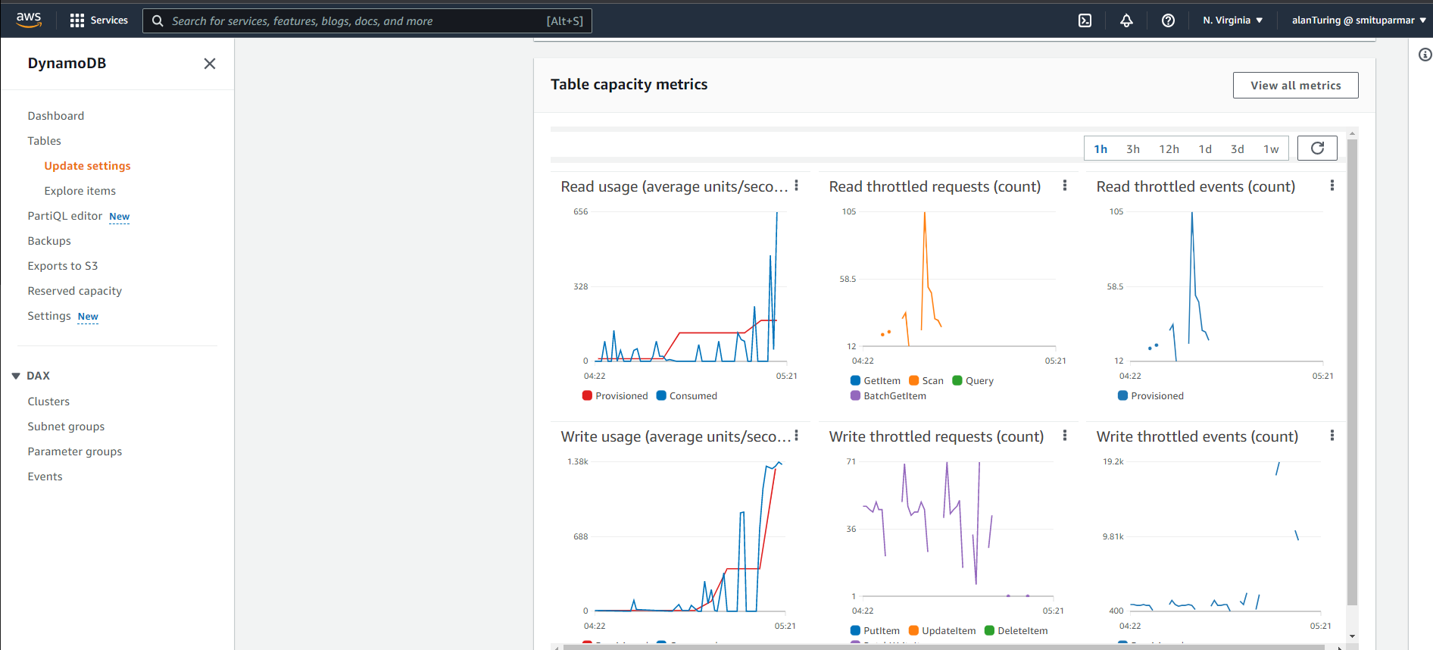
Metrics

Slide 10
Serverless Application with Lambda and DynamoDB
After uploading data, we made one web application by using react framework which can take product ID and can trigger AWS Lambda API to get the results
Lambda has capacity to increase its resources which is vertical scaling. Meanwhile, we have assigned 3000 read request units in DynamoDB(AWS assigns new instance/query engine for each 700-1000 request units) which can be called horizontal scaling

Slide 11
Serverless Application with Lambda and DynamoDB (Cont’d…)
React framework calls lambda endpoint by using axios package and wait for data. This way we are triggering Lambda APIs which is built in Node.js.
Lambda API will request DyanamoDB for data and will collect at max 100 reviews and will send it back to web application. As the number of user will grow, lambda will increase its capacity and distribute the load.
Additionally, we have made one replica of database in different availability zone(canada-central) and main database in North virginia region.

Slide 12
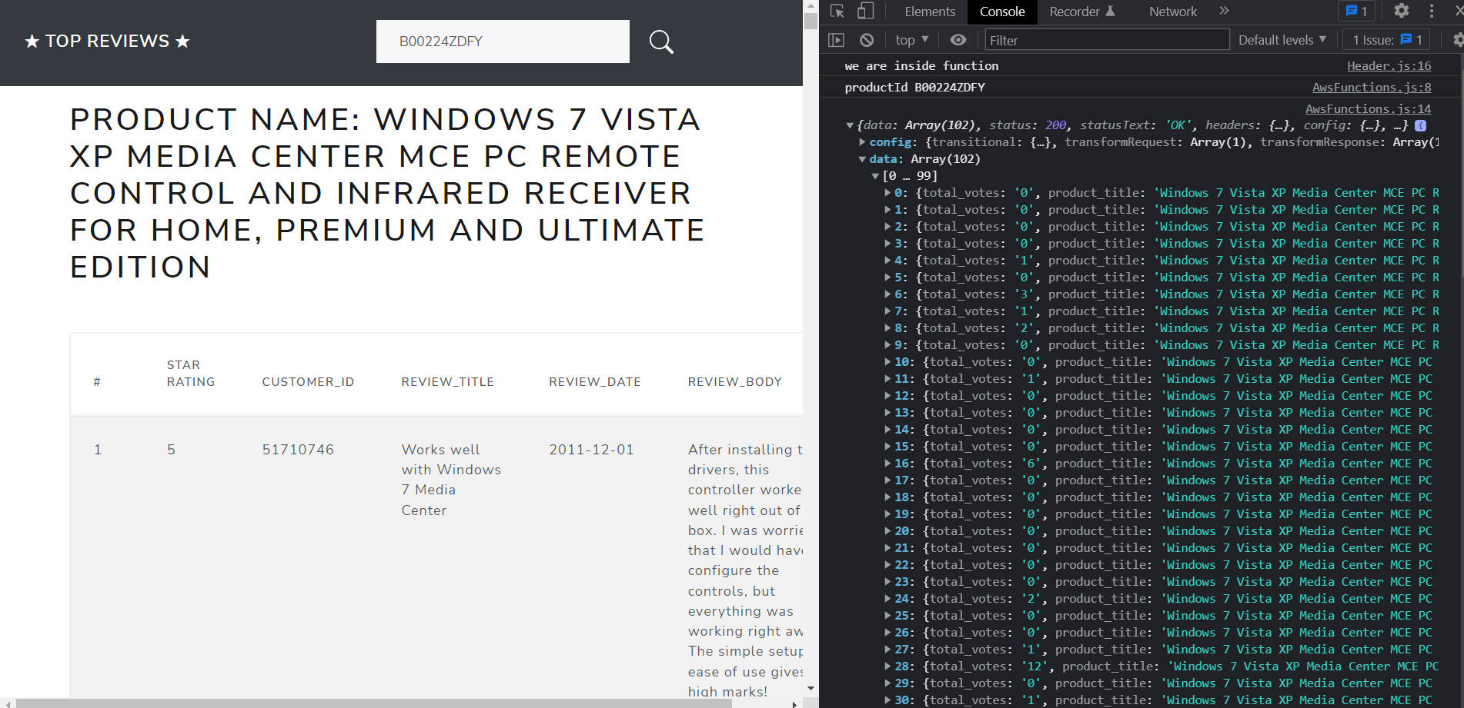
Application in Action

Slide 13
Challenges Faced
Lambda has timeout of 15 minutes thus one invocation can run at max for 15 minutes. At initial point, our provisioned write capacity was 25 and we weren’t able to get any significant result after one run.
AWS has different price rate for provisioned capacity units. 25 read and 25 write units are totally free but it will take too much time as 1 unit will read upto 1 KB per second. After 25 units prices will increase drastically. Thus cost-performance trade-off comes into the picture and we can choose only either of one.

Slide 14
Challenges Faced (Cont’d…)
DynamoDB APIs can check 1 MB of data per request at most thus sometimes, we need to make several API calls for getting one result. This will take too much time because of transmission delay.
At initial point, we implemented query inside frontend part. Because of that every user can have access of AWS credentials which makes it very insecure. Thus, we transferred everything to AWS lambda which makes it serverless as well as secure and robust.

Slide 15
References
https://www.kaggle.com/datasets/cynthiarempel/amazon-us-customer-reviews-dataset?select=amazon_reviews_us_Books_v1_02.tsv
https://docs.aws.amazon.com/amazondynamodb/latest/developerguide/HowItWorks.API.html
https://docs.aws.amazon.com/lambda/latest/dg/lambda-python.html
https://docs.aws.amazon.com/lambda/latest/dg/lambda-nodejs.html
https://docs.aws.amazon.com/apigateway/latest/developerguide/http-api-dynamo-db.html#http-api-dynamo-db-create-function
https://docs.aws.amazon.com/amazondynamodb/latest/developerguide/HowItWorks.ReadWriteCapacityMode.html

Slide 16
Thank you

